Slide 1
Exercise
Accept three numbers from the user and store them in memory addresses 60, 61, and 62. Then add these three numbers and store the result in memory address 65. Finally, print the result.
INP
STA 60
INP
STA 61
INP
STA 62
LDA 60
ADD 61
ADD 62
STA 65
LDA 65
OUT
HLT

Slide 2
Modify Program Using Variables
Now modify the program to store data in variables A, B, C instead of memory addresses 60, 61, 62. Store them sum in variable D. Display value of D at the end.
INP
STA A
INP
STA B
INP
STA C
LDA A
ADD B
ADD C
STA D
LDA D
OUT
HLT
A DAT
B DAT
C DAT
D DAT

Slide 3
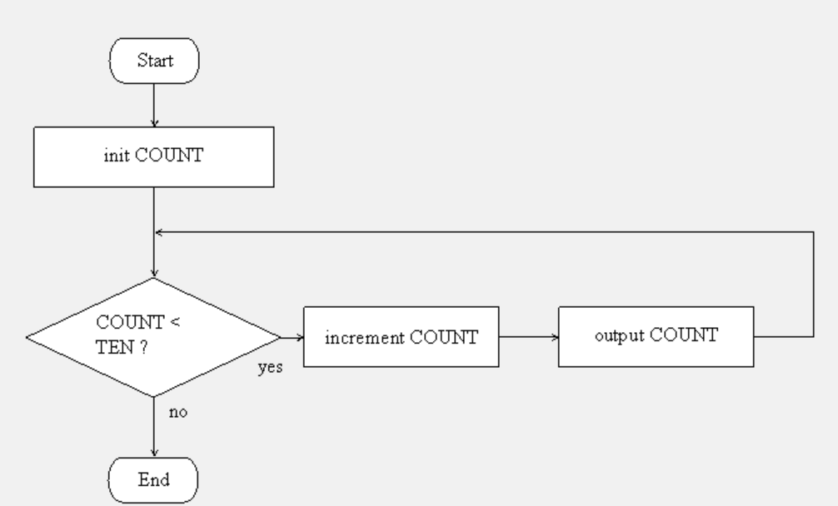
Write a program to Run a Loop 10 Times

Slide 4
Code
Code explanation
After the program is loaded, memory locations 0 to 9 will get filled with instructions of the code. HLT will be at memory location 10.
DAT instructions will reserve memory location 11 to store a value 001 and call it as ONE, location 12 to store a value 010 and call it as TEN, and location 13 to store COUNT with no initial value.
LOOPTOP is the first instruction in the loop. A BRANCH instruction will cause jump back to the start of the loop. In the loop, COUNT is loaded into accumulator, one is added to it, new value is displayed, and the new COUNT value is stored back in memory.
The SUB instruction decrements the value of variable TEN (which is always 10 in our program) from the accumulator. The BRP condition checks if accumulator is 0, and if yes, branches to ENDLOOP instruction.
LDA ONE
STA COUNT
OUT
LOOPTOP LDA COUNT
ADD ONE
OUT
STA COUNT
SUB TEN
BRP ENDLOOP
BRA LOOPTOP
ENDLOOP HLT
ONE DAT 001
TEN DAT 010
COUNT DAT

Slide 5
Using the Little Man Computer on our own PC
https://sourceforge.net/projects/lmce/

Slide 6
The ‘Bus’ Concept

Slide 7
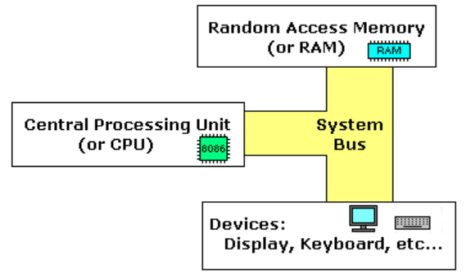
Computer Bus
Computer bus: A communication link (set of wires) used inside a computer to send data, addresses, control signals, and power to various hardware components
Buses connect various hardware components to each other
Main bus types: Connect CPU to RAM
Address bus: Used for specifying memory addresses for reading or writing of data (Unidirectional)
Data bus: Specifies data to be written or contains data that was read (Bidirectional)
Control bus: Used for passing control signals (Bidirectional)
Address bus + Data bus + Control bus = System bus

Slide 8
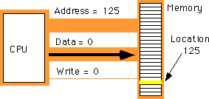
How is the System Bus Used?
Suppose the CPU wants to write a value of 0 in memory location 125
Address bus = Specifies the address of the memory location
Data bus = Specifies the data to be written
Control bus = Specifies the write operation

Slide 9
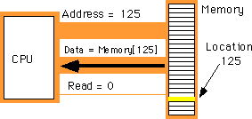
How is the System Bus Used?
Suppose the CPU wants to read data stored in memory location 125
Address bus = Specifies the address of the memory location
Control bus = Specifies the read operation
Data bus = Will contain the data read from memory location 125

Slide 10
Instructions
Data bus = Transfer data from the CPU to the main memory or from the main memory to the CPU
Remember, code is also in the main memory
CPU needs to fetch each instruction from the main memory and execute it
Which bus will be used to fetch the instructions from the main memory into the CPU?

Slide 11
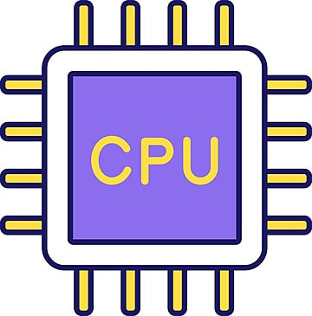
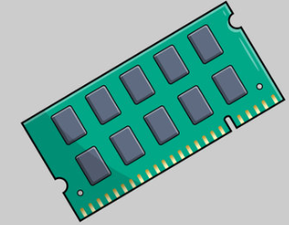
von Neumann versus Harvard Architecture
von Neumann Architecture
Single memory for data and instructions
Single bus
Simple, Inexpensive
Simultaneous multiple memory fetches not possible
von Neumann bottleneck: Separation of memory and data
Harvard Architecture
Separate memory and separate bus for data and instructions
Multi bus
Complex, Expensive
Simultaneous two memory fetches possible
Data and Instructions Bus
Data Bus
Instructions Bus

